Slide 1
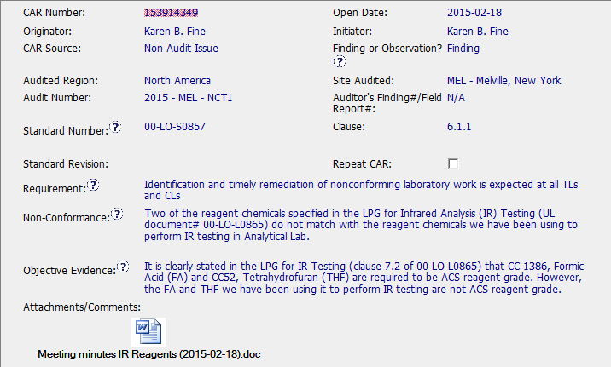
CAR 153914349

Slide 2
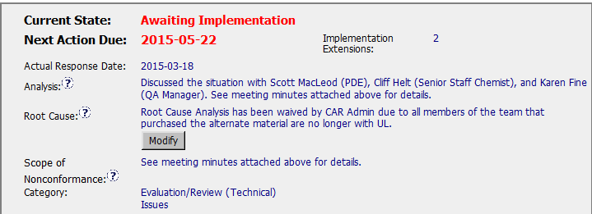
CAR 153914349
Need to verify the attachment to know the detailed analysis. I would recommend to have a “summary” here would be better.
I would choose “Procurement Issues” instead of this general category.
“Products or services obtained from non-approved sources.”
We still can not waive root cause or we have no idea how to prevent future similar NCR..

Slide 3
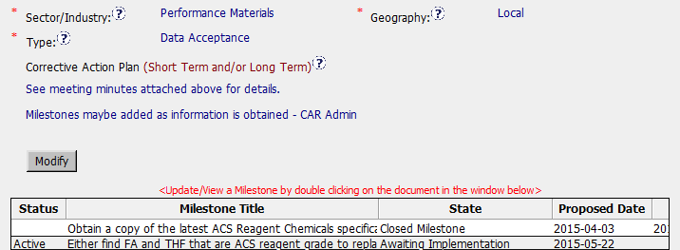
CAR 153914349
I would recommend select Type as “Purchasing”.
Lack of ”Containment” for Finding CAR. If no need, please state the reason.
Lack of “Owner’s Verification” for Finding CAR.

Slide 4
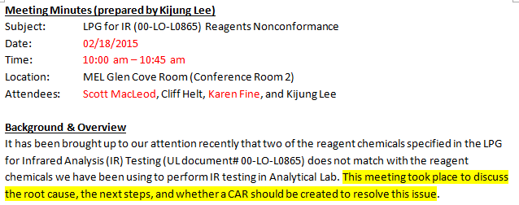
CAR 153914349
LAB staff, PDE and CAR Champion join the meeting.

Slide 5
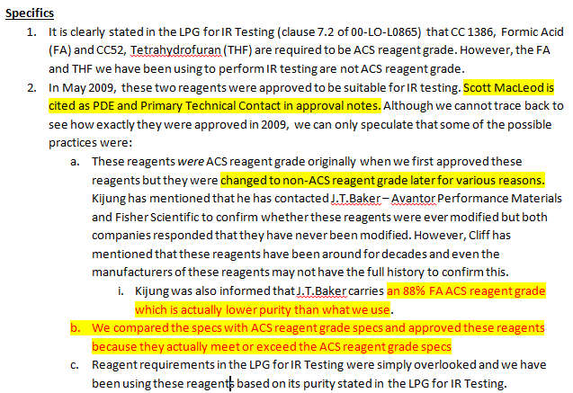
CAR 153914349
This detailed spec was not confirmed untiled we implement first milestone.

Slide 6
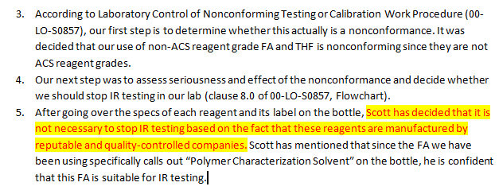
CAR 153914349
I would recommend this may put in Corrective Action Plan as the rational not to provide containment action.

Slide 7
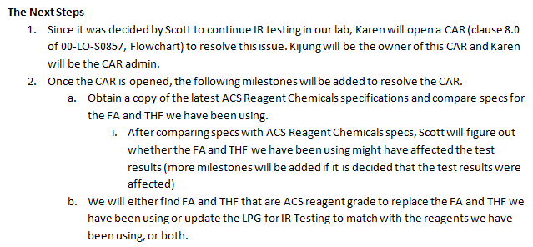
CAR 153914349
Corrective Action Plan seems copy from this item 2, but lack of consider “Containment” and “Owner’s Verification”

Slide 8
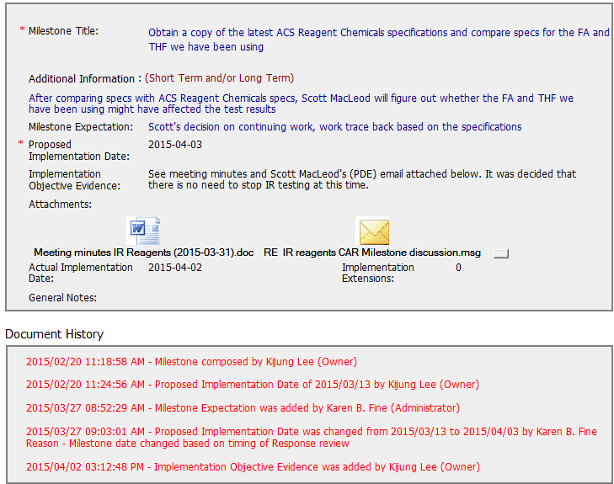
CAR 153914349

Slide 9
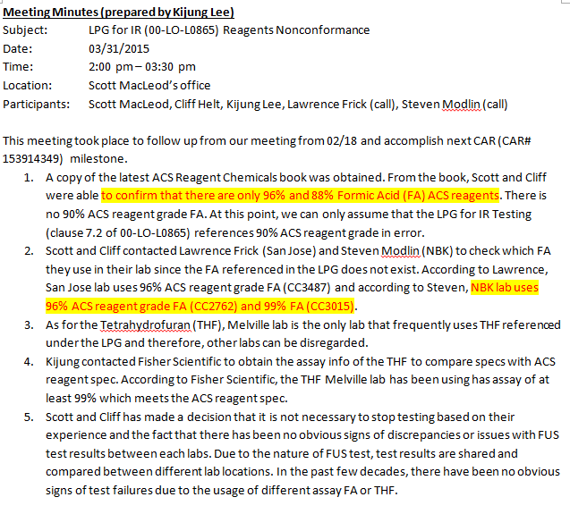
CAR 153914349
Item 1 conflict to Item 2 –
If only 96% & 88 % FA ACS reagents, how come NBK have 99% FA (CC3015)
I would recommend this may put in Corrective Action Plan as the rational not to provide containment action.

Slide 10
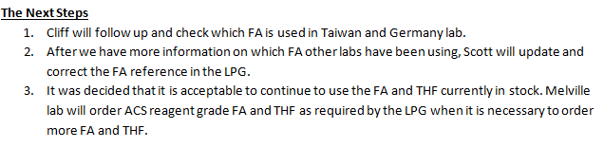
CAR 153914349
The spec analysis seems not completed for this milestone to close.

Slide 11
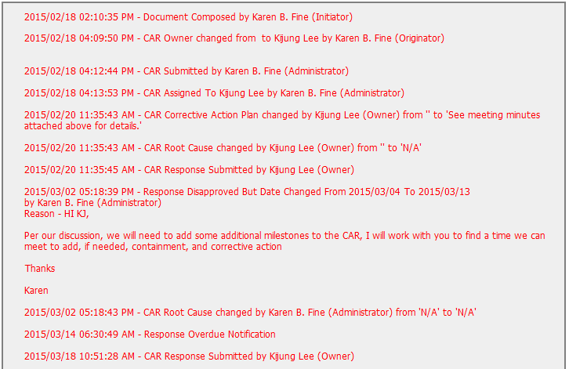
CAR 153914349

Slide 12
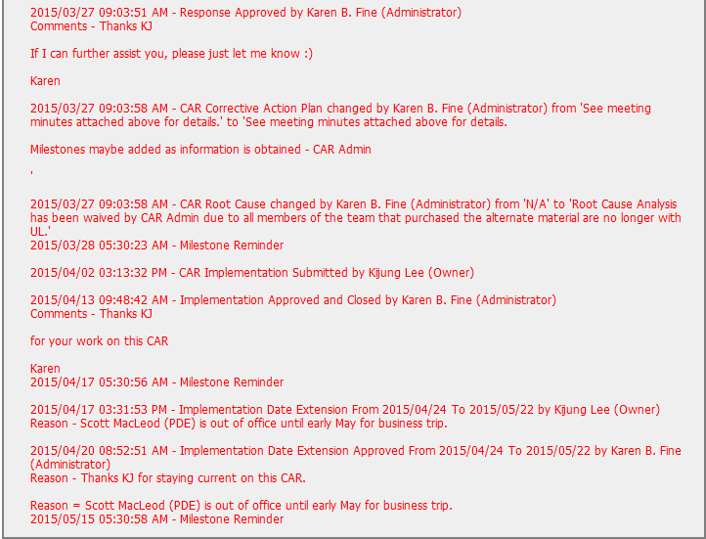
CAR 153914349

Slide 13
CAR 153914349 – CBS Check
CBS Requirements | Excellent | Moderate | Need Improve | N/A
(C) Extensions are within requirement (<30 days, 3 or less) |  | X
(T) Most appropriate ‘category’, ‘type’, ‘geography’ are selected |  |  | X
(P) Facilitates the handling of disputed CARs |  |  |  | X
(T) Acts on CARs within required timeframe |  | X
(C) Analysis shows clear path to root cause and scope; stakeholders identified |  |  | X
(C) Root cause statement is succinct, reasonable, complete (Shows ‘N/A’ for observations) |  |  | X
(C) Corrective actions fix the objective evidence and other problems found; address entire root cause and scope. For observations, they do not go beyond fixing the objective evidence |  |  | X
(C) Milestones address containment & owner’s verification; completed per milestone expectations |  |  | X
(P) Verification per requirements |  |  | X
(L) Referenced communications are attached as needed | X
(C L) Evidence of communication for overdue/escalated CARs and other pertinent concerns |  |  |  | X
(P) Trains other CAR Champions |  |  |  | X

Slide 14
THANK YOU

Slide 15
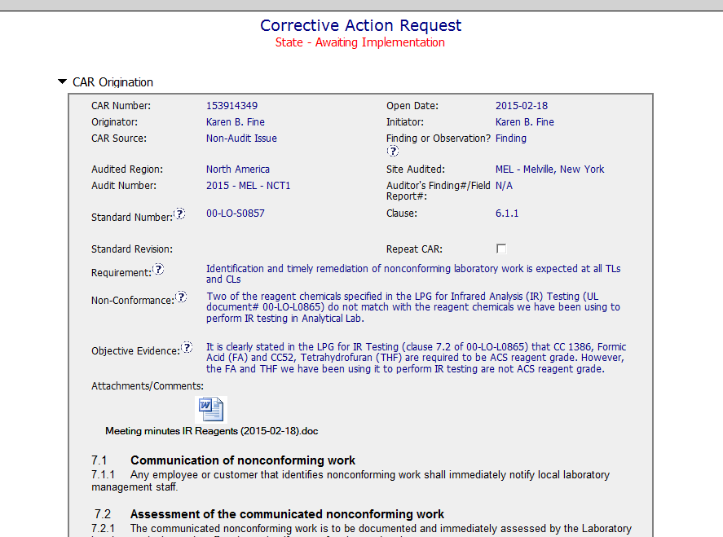

CAR 153914349 - Finding
Per 00-LO-S0857: Note: To facilitate tracking of nonconforming work CARs, the nonconformance should be written against this SOP or against 17025 clause 4.9.
Clear Non-Conformance Statement and Objective Evidence

Slide 16
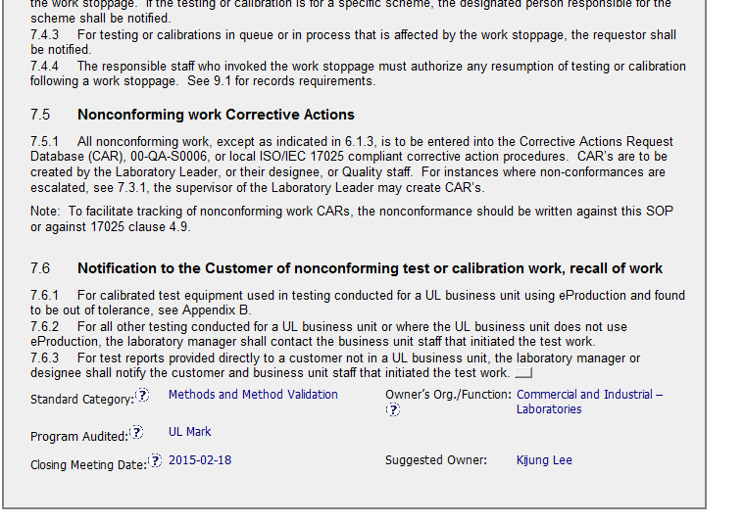
CAR 153914349 - Finding
The CAR Admin included verbiage from 00-LO-S0857 in the CAR under Attachments/Comments which indicated how nonconforming work should be handled.

Slide 17
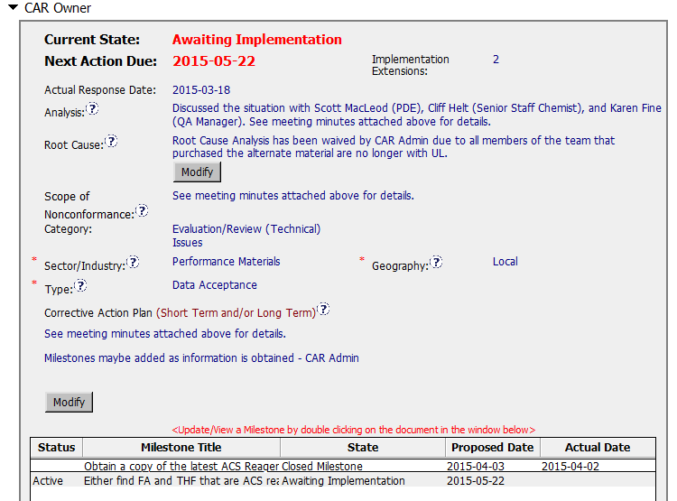

CAR 153914349 - Finding
Per 00-QA-S0006, there is no option for the CAR Admin to waive the Root cause.
According to 00-QA-S0006 Clause 7.4.3, finding CARs require at least two milestones that include containment and verification. In the Corrective Action plan, Short Term action should be named as Containment. Long Term action should be named as Verification action.

Slide 18
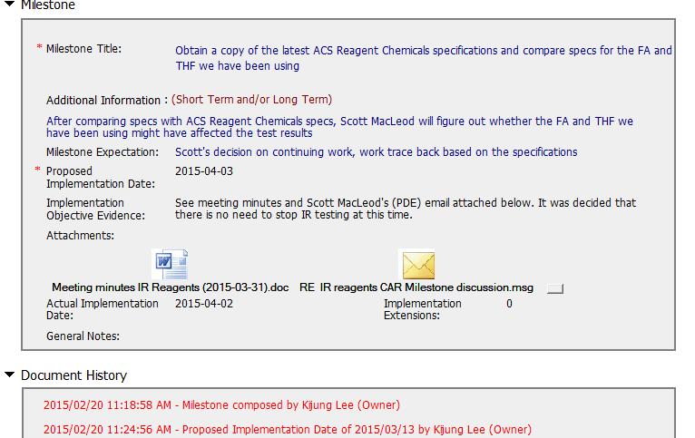
CAR 153914349 – Milestone 1
Containment Milestone: Per stakeholders, it was determined current testing could continue. No trace-back would be required.
Clearly detailed meeting minutes were attached.

Slide 19
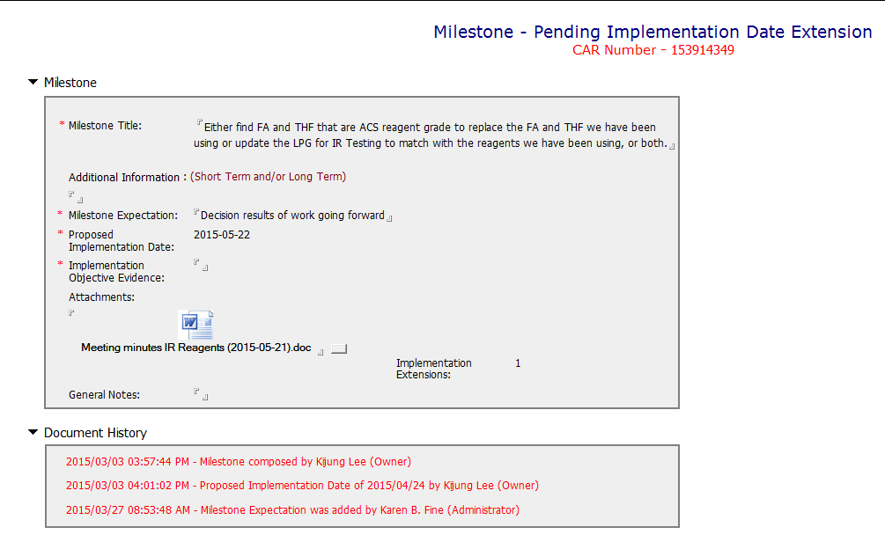
CAR 153914349 – Milestone 2
The information in the Milestone Title is really part of the expectation. As of today (5/27/15) the Milestone is pending a date extension.

Slide 20
CAR 153914349 – CBS Check
CBS Requirements | Excellent | Moderate | Need Improve | N/A
(C) Extensions are within requirement (<30 days, 3 or less) | X
(T) Most appropriate ‘category’, ‘type’, ‘geography’ are selected | X
(P) Facilitates the handling of disputed CARs |  |  |  | X
(T) Acts on CARs within required timeframe | X
(C) Analysis shows clear path to root cause and scope; stakeholders identified |  |  | X
(C) Root cause statement is succinct, reasonable, complete (Shows ‘N/A’ for observations) |  |  | X
(C) Corrective actions fix the objective evidence and other problems found; address entire root cause and scope. For observations, they do not go beyond fixing the objective evidence |  |  | X
(C) Milestones address containment & owner’s verification; completed per milestone expectations |  |  | X
(P) Verification per requirements |  |  |  | X
(L) Referenced communications are attached as needed | X
(C L) Evidence of communication for overdue/escalated CARs and other pertinent concerns |  |  |  | X
(P) Trains other CAR Champions |  |  |  | X

